Slide 1
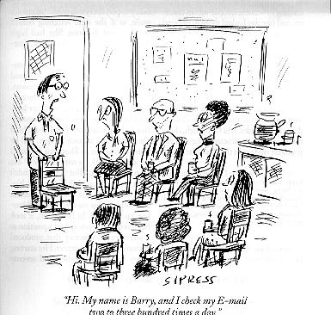
Mail and More Mail
Dr. Shelly Heller
sheller@gwu.edu

Slide 2
Chapter 2: Application Layer
Chapter goals:
conceptual + implementation aspects of network application protocols
  client server paradigm
  service models
learn about protocols by examining popular application-level protocols
More chapter goals
specific protocols:
  http
  ftp
  smtp
  pop
  dns
programming network applications
  socket programming

Slide 3

Electronic Mail
outgoing
message queue
Three major components:
user agents
mail servers
simple mail transfer protocol: smtp
User Agent
a.k.a. “mail reader”
composing, editing, reading mail messages
e.g., Eudora, Outlook, elm, Netscape Messenger
outgoing, incoming messages stored on server
user
agent
user mailbox
mail
server
user
agent
SMTP
mail
server
user
agent
SMTP
SMTP
mail
server
user
agent
user
agent
user
agent

Slide 4
Electronic Mail: mail servers
Mail Servers
mailbox contains incoming messages (yet to be read) for user
message queue of outgoing (to be sent) mail messages
smtp protocol between mail servers to send email messages
  client: sending mail server
  “server”: receiving mail server
user
agent
mail
server
user
agent
SMTP
mail
server
user
agent
SMTP
SMTP
mail
server
user
agent
user
agent
user
agent

Slide 5
Electronic Mail: smtp [RFC 821]
uses tcp to reliably transfer email msg from client to server, port 25
direct transfer: sending server to receiving server
three phases of transfer
  handshaking (greeting)
  transfer of messages
  closure
command/response interaction
  commands: ASCII text
  response: status code and phrase
messages must be in 7-bit ASCII

Slide 6
telnet www.hellers.com 25
Trying 222.222.222.222...
Connected to www.hellers.com.
Escape character is '^]'.
220 aaa.xxxyyy.com ESMTP Sendmail 8.11.0/8.11.0; Mon, 3 Sep 2001 17:35:410 0400 (EDT)
helo steve@hellers.com
501 5.0.0 Invalid domain name
HELO steve
250 aaa.xxxyyy.com Hello hobbes.seas.gwu.edu [128.164.156.40], pleased to meet you
MAIL FROM <shelly> NOTE CRLF omitted for space
Date: Mon, 03 Sep 2001 17:37:24 -0400
X-Accept-Language: en
To: sheller@seas.gwu.edu
Subject: sample msg
X-NoFilter: GLOBAL
X-Sixpack: IP 207.197.221.3 is in ORBZ.org inputs. NOTE CRLF omitted for space
This is a multi-part message in MIME format.
--------------84984C274826A9893636B52F
Content-Type: text/plain; charset=us-ascii
Content-Transfer-Encoding: 7bit

Slide 7
RFC SMTP
+----------+ +----------+
+------+ | | | |
| User |<-->| | SMTP | |
+------+ | Client- |Commands/Replies| Server- |
+------+ | SMTP |<--------------> | SMTP | +------+
| File |<-->| | and Mail | |<-->| File |
|System| | | | | |System|
+------+ +----------+ +----------+ +------+
SMTP client SMTP server
Notes:
When an SMTP client has a message to transmit, it establishes a two- way transmission channel to an SMTP server. The responsibility of an SMTP client is to transfer mail messages to one or more SMTP servers, or report its failure to do so.

Slide 8
smtp: final words
smtp uses persistent connections
smtp requires that message (header & body) be in 7-bit ASCII
certain character strings are not permitted in message (e.g., CRLF.CRLF). Thus message has to be encoded (usually into either base-64 or quoted printable)
smtp server uses CRLF.CRLF to determine end of message
Comparison with http
http: pull
email: push
both have ASCII command/response interaction, status codes
http: each object is encapsulated in its own response message
smtp: multiple objects message sent in a multipart message

Slide 9
Mail message format
smtp: protocol for exchanging email msgs
RFC 822: standard for text message format:
header lines, e.g.,
  To:
  From:
  Subject:
  different from smtp commands!
body
  the “message”, ASCII characters only
header
blank
line
body

Slide 10
Message format: multimedia extensions
MIME: multimedia mail extension, RFC 2045, 2056
additional lines in msg header declare MIME content type
From: alice@crepes.fr
To: bob@hamburger.edu
Subject: Picture of yummy crepe.
MIME-Version: 1.0
Content-Transfer-Encoding: base64
Content-Type: image/jpeg
base64 encoded data .....
.........................
......base64 encoded data
MIME version
method used
to encode data
multimedia data
type, subtype,
parameter declaration
encoded data

Slide 11
Sample MIME msg
This is a multi-part message in MIME format.
--------------0E77B48F36F1E7D301E6FFC3 NOTE SEPARATOR
Content-Type: text/plain; charset=us-ascii
Content-Transfer-Encoding: 7bit
Dear Chairs,
Several of you have ask for data on fall enrollments. Attached is a
summary chart based on SEAS Subjects. Enrollments are the number of students appearing on your class lists...
--------------0E77B48F36F1E7D301E6FFC3 NOTE SEPARATOR
Content-Type: application/msexcel;
name="Fall 2001 Credit hour compar.xls"
Content-Transfer-Encoding: base64
Content-Disposition: inline;
filename="Fall 2001 Credit hour compar.xls"
0M8R4KGxGuEAAAAAAAAAAAAAAAAAAAAAPgADAP7/C

Slide 12
MIME types
Content-Type: type/subtype; parameters
Text
example subtypes: plain, html
Image
example subtypes: jpeg, gif
Audio
example subtypes: basic (8-bit μ-law encoded), 32k adpcm (32 kbps coding)
Video
example subtypes: mpeg, quicktime
Application
other data that must be processed by reader before “viewable”
example subtypes: msword, octet-stream

Slide 13
Multipart Type
From: alice@crepes.fr
To: bob@hamburger.edu
Subject: Picture of yummy crepe.
MIME-Version: 1.0
Content-Type: multipart/mixed; boundary=98766789
--98766789
Content-Transfer-Encoding: quoted-printable
Content-Type: text/plain
Dear Bob,
Please find a picture of a crepe.
--98766789
Content-Transfer-Encoding: base64
Content-Type: image/jpeg
base64 encoded data .....
.........................
......base64 encoded data
--98766789--

Slide 14


Mail access protocols
SMTP
SMTP
POP3 or
IMAP
user
agent
user
agent
sender’s mail
server
receiver’s mail
server
SMTP: delivery/storage to receiver’s server
Mail access protocol: retrieval from server
  POP: Post Office Protocol [RFC 1939]
    authorization (agent <-->server) and download
  IMAP: Internet Mail Access Protocol [RFC 1730]
    more features (more complex)
    manipulation of stored msgs on server
  HTTP: Hotmail , Yahoo! Mail, etc.

Slide 15
POP3 protocol
S: +OK POP3 server ready
C: user alice
S: +OK
C: pass hungry
S: +OK user successfully logged on
authorization phase
client commands:
  user: declare username
  pass: password
server responses
  +OK
  -ERR
transaction phase, client:
list: list message numbers
retr: retrieve message by number
dele: delete
quit
C: list
S: 1 498
S: 2 912
S: .
C: retr 1
S: <message 1 contents>
S: .
C: dele 1
C: retr 2
S: <message 1 contents>
S: .
C: dele 2
C: quit
S: +OK POP3 server signing off

Slide 16
IMAP protocol
IMAP was originally developed in 1986 at Stanford University
Key goals for IMAP include:
Be fully compatible with Internet messaging standards, e.g. MIME.
Allow message access and management from more than one computer.
Allow access without reliance on less efficient file access protocols.
Provide support for "online", "offline", and "disconnected" access modes *
Support for concurrent access to shared mailboxes
Client software needs no knowledge about the server's file store format.
IMAP History

Slide 17
Interactive Mail Access Protocol vs Post Office Protocol
POP – the first tcp/ip mail version
Off line access – mail retrieved and deleted from server
Where is the mail permanently?
What’s the problem?
POP attempts to address this
IMAP mail retrieved for local use but remains on server. What about changes to mailbox?
“disconnected mailbox” online and offline benefits
Notes:
To be online all the time - - even today most client machines only connected for specific periods., so don’t have to be online, but lose benefit of central storage
Access? Security? Backups
BUT online always? POP changes – keeping track of old and new
IMPA – changes synchronized access and retrieve mail from remote server, flags to keep track of messages, multiple mailboxes, infor about message before downloading it, download only parts,

Slide 18
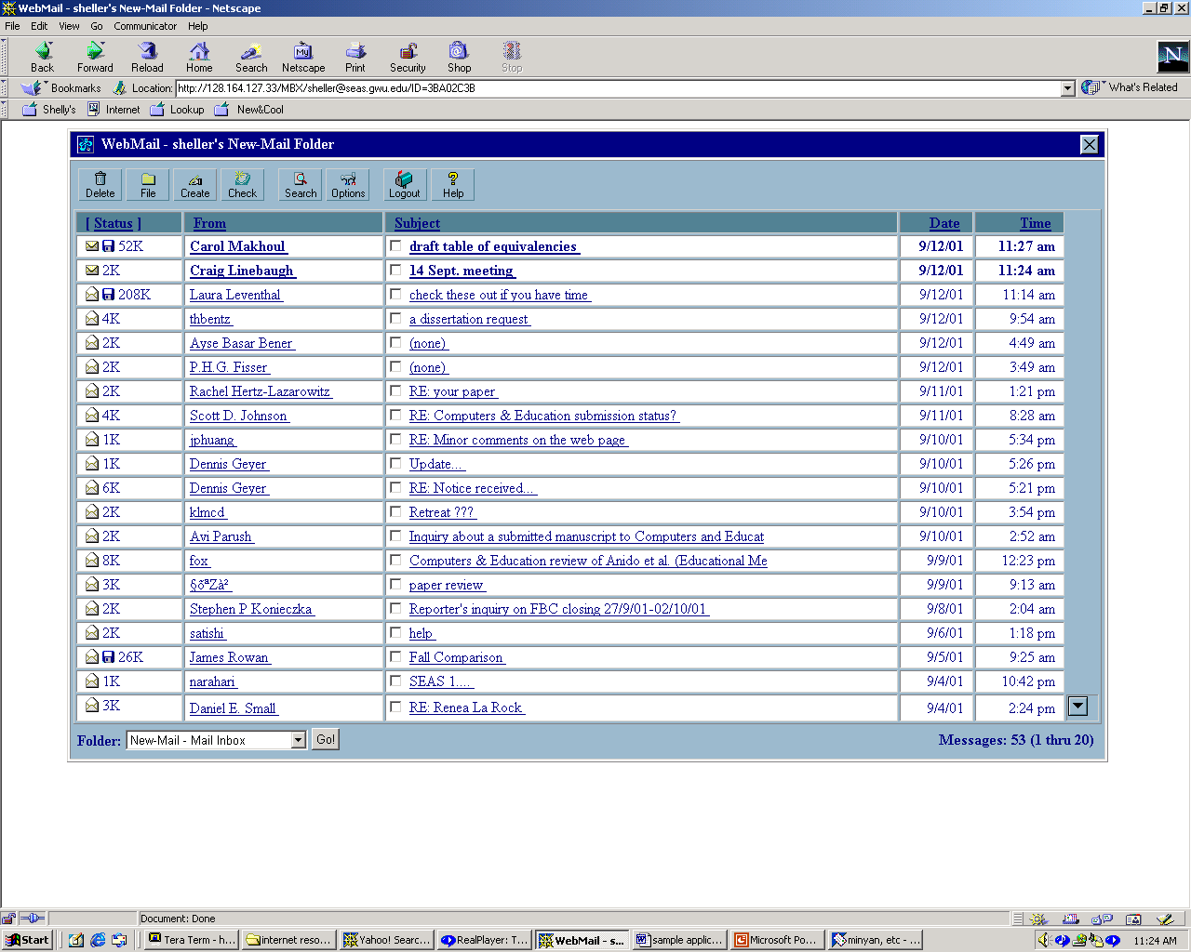
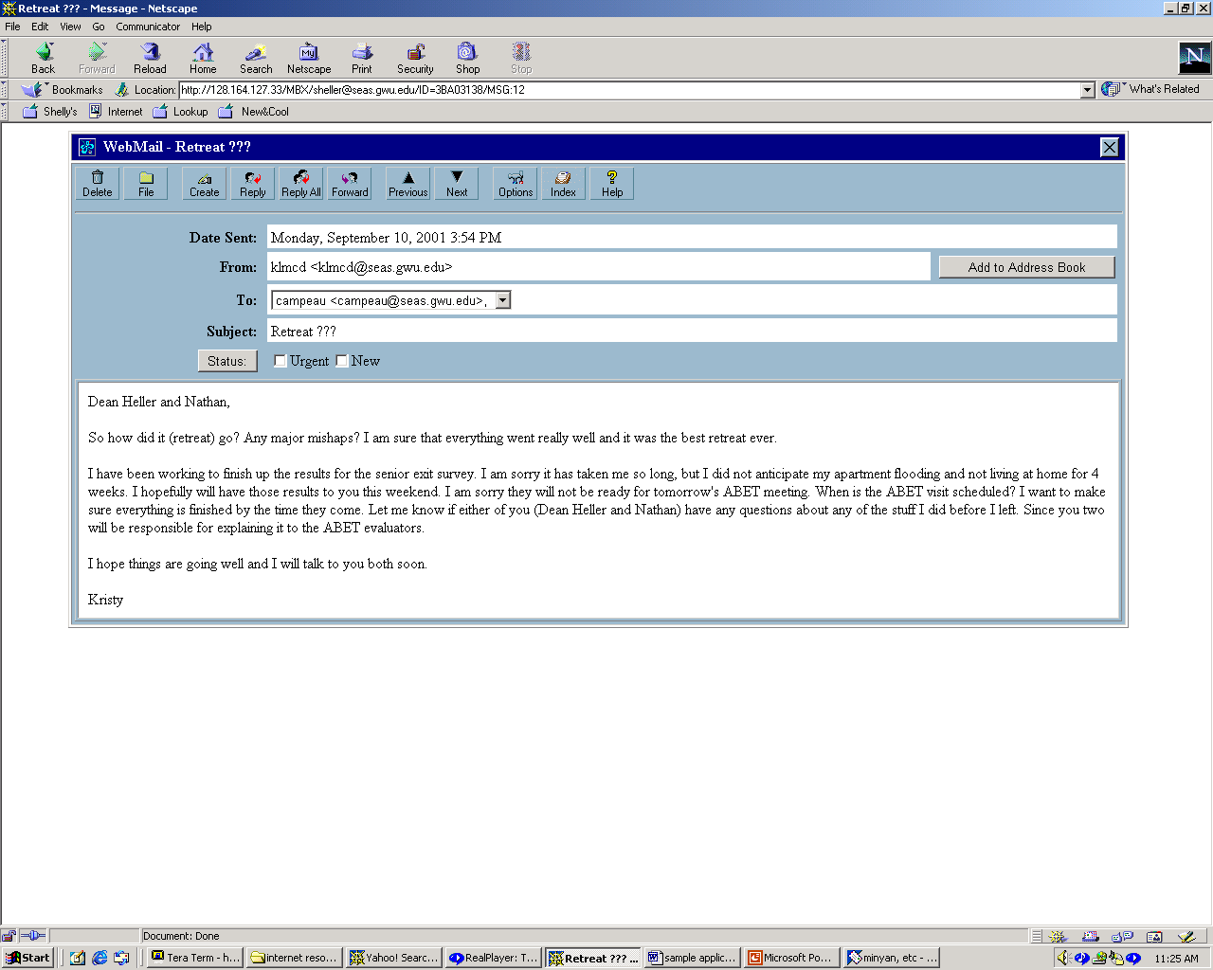
IMAP “As If” via HTTP
Folders
Components

Slide 19
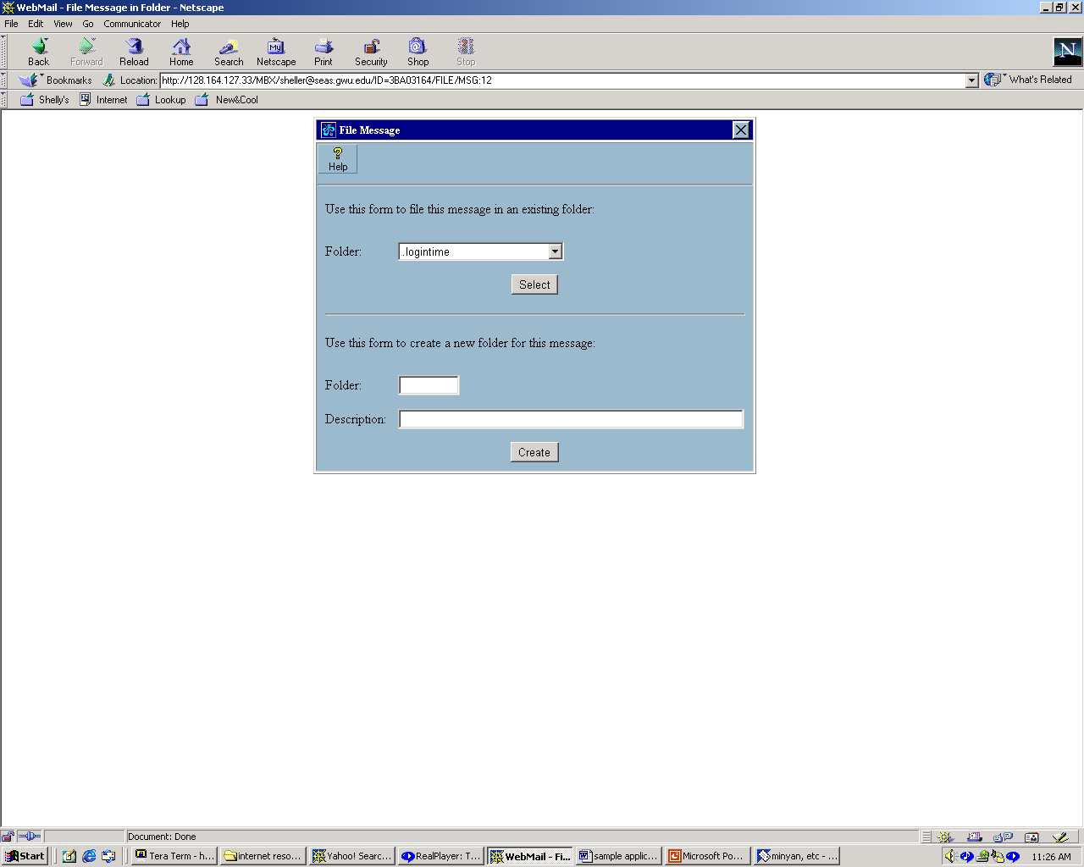
IMAP “As If….” via HTTP AKA Webmail
Always in one of 4 states:
Unauthenticated – user id etc.
Authenticated – user select folders
Selected – user commands
Logout - termination
Notes:
an email system in which a user can access their emails via a browser on any computer or device that is connected to the Internet.
Webmail's primary difference from client-based email is how you access it. Webmail is accessed on the Internet through a Web browser while client-based email is accessed through a desktop program. Webmail messages are stored online on the site's servers and protected by your username and password. Client-based email systems store messages on your computer, and generally require no authentication to access. Webmail can be accessed from any computer, making it convenient when you don't have your computer on-hand. However, entering your authentication information into a public computer can be dangerous and may expose your account to hackers.

Slide 20
DNS: Domain Name System
People: many identifiers:
  SSN, name, Passport #
Internet hosts, routers:
  IP address (32 bit) - used for addressing datagrams
  “name”, e.g., algernon.eccs.usma.edu - used by humans
Q: map between IP addresses and name ?
Domain Name System:
World’s largest distributed database implemented in hierarchy of many name servers
application-layer protocol host, routers, name servers to communicate to resolve names (address/name translation)
  note: core Internet function implemented as application-layer protocol
  complexity at network’s “edge”

Slide 21
The Need for DNS
“In the long run, it will not be practical for every internet host to include all internet hosts in its name-address tables. Even now, with the over 400 names and nicknames in the combined ARPANET-DCNET tables, this has become awkward.”
Reference RFC 799 rfc 799 (1981)
ICANN History Project

Slide 22
ICANN
What does it do?
  Updates the DNS
  Coordinates IP addresses
  Coordinate with Root serves
  Universal resolvability
What doesn’t it do?
  Control the internet
Notes:
Wherever you are – you get the same results

Slide 23
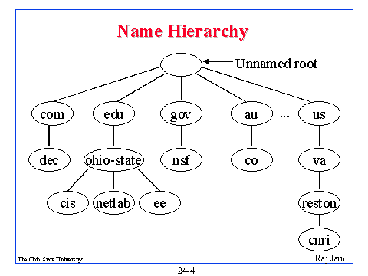
Name Structure
What about .tv

Slide 24
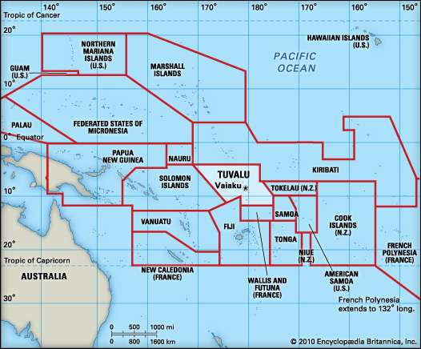
What about .tv

Slide 25
DNS name servers
Why not centralize DNS?
single point of failure
traffic volume
distant centralized database
maintenance
doesn’t scale!
no server has all name-to-IP address mappings
local name servers:
  each ISP, company has local (default) name server
  host DNS query first goes to local name server
authoritative name server:
  for a host: stores that host’s IP address, name
  can perform name/address translation for that host’s name

Slide 26
Vocabulary
Name servers – answers queries for records in zones they have authority for, query others
Resolvers – act as intermediaries between applications and name servers, translate application requests to DNS messages, interpret DNS messages
Root Name Servers – 13 around the world, refer to name servers serving top-level zone (North America (10, DC 6 CA 4),Europe (2 London, Stockholm), Asia (1, Tokyo)
Notes:
220 IP addresses represent 50% of queries

Slide 27
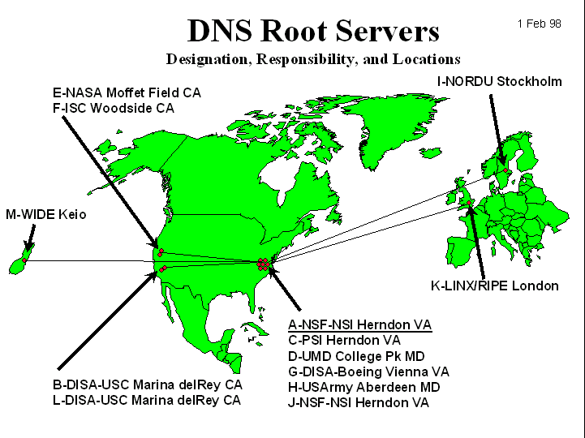
DNS: Root name servers
contacted by local name server that can not resolve name
root name server:
  contacts authoritative name server if name mapping not known
  gets mapping
  returns mapping to local name server
~ dozen root name servers worldwide
http://www.cymru.com/DNS/dns.html

Slide 28
Simple DNS example
root name server
host surf.eurecom.fr wants IP address of gaia.cs.umass.edu
1. Contacts its local DNS server, dns.eurecom.fr
2. dns.eurecom.fr contacts root name server, if necessary
3. root name server contacts authoritative name server, dns.umass.edu, if necessary
2
4
5
3
authoritative name server
dns.umass.edu
local name server
dns.eurecom.fr
1
6
requesting host
surf.eurecom.fr
gaia.cs.umass.edu

Slide 29
DNS example
root name server
Root name server:
may not know authoritative name server
may know intermediate name server: who to contact to find authoritative name server
6
2
7
3
local name server
dns.eurecom.fr
intermediate name server
dns.umass.edu
4
5
1
8
authoritative name server
dns.cs.umass.edu
requesting host
surf.eurecom.fr
gaia.cs.umass.edu

Slide 30
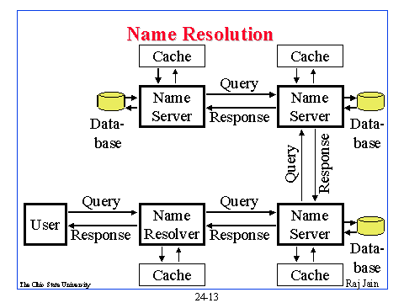
DNS system with DB and Cache

Slide 31
DNS: iterated queries
root name server
recursive query:
puts burden of name resolution on contacted name server
heavy load?
iterated query:
contacted server replies with name of server to contact
“I don’t know this name, but ask this server”
iterated query- its an edu, go to TDL for edu
2
3
4
5
local name server
dns.eurecom.fr
intermediate name server
dns.umass.edu
6
7
1
8
authoritative name server
dns.cs.umass.edu
requesting host
surf.eurecom.fr
gaia.cs.umass.edu

Slide 32
DNS: caching and updating records
once (any) name server learns mapping, it caches mapping
  cache entries timeout (disappear) after some time
update/notify mechanisms under design by IETF
  RFC 2136
  http://www.ietf.org/html.charters/dnsind-charter.html

Slide 33
DNS records
DNS: distributed db storing resource records (RR)
RR format: (name, value, type, ttl)
Type=A
  name is hostname
  value is IP address
Type=CNAME
  name is an alias name for some “canonical” (the real) name
  value is canonical name
Type=NS
  name is domain (e.g. foo.com)
  value is IP address of authoritative name server for this domain
Type=MX
  value is hostname of mailserver associated with name

Slide 34
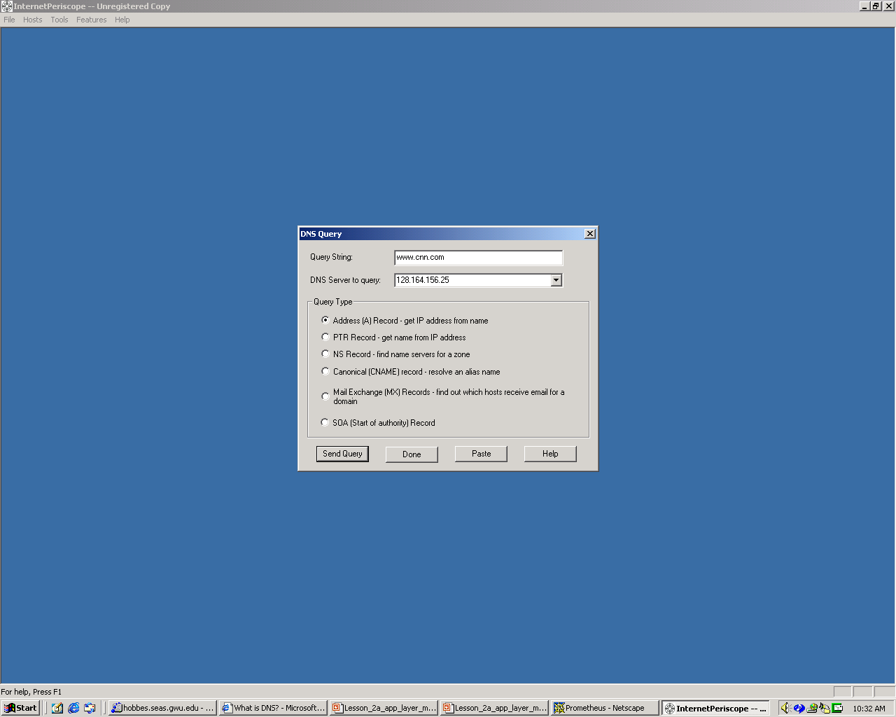
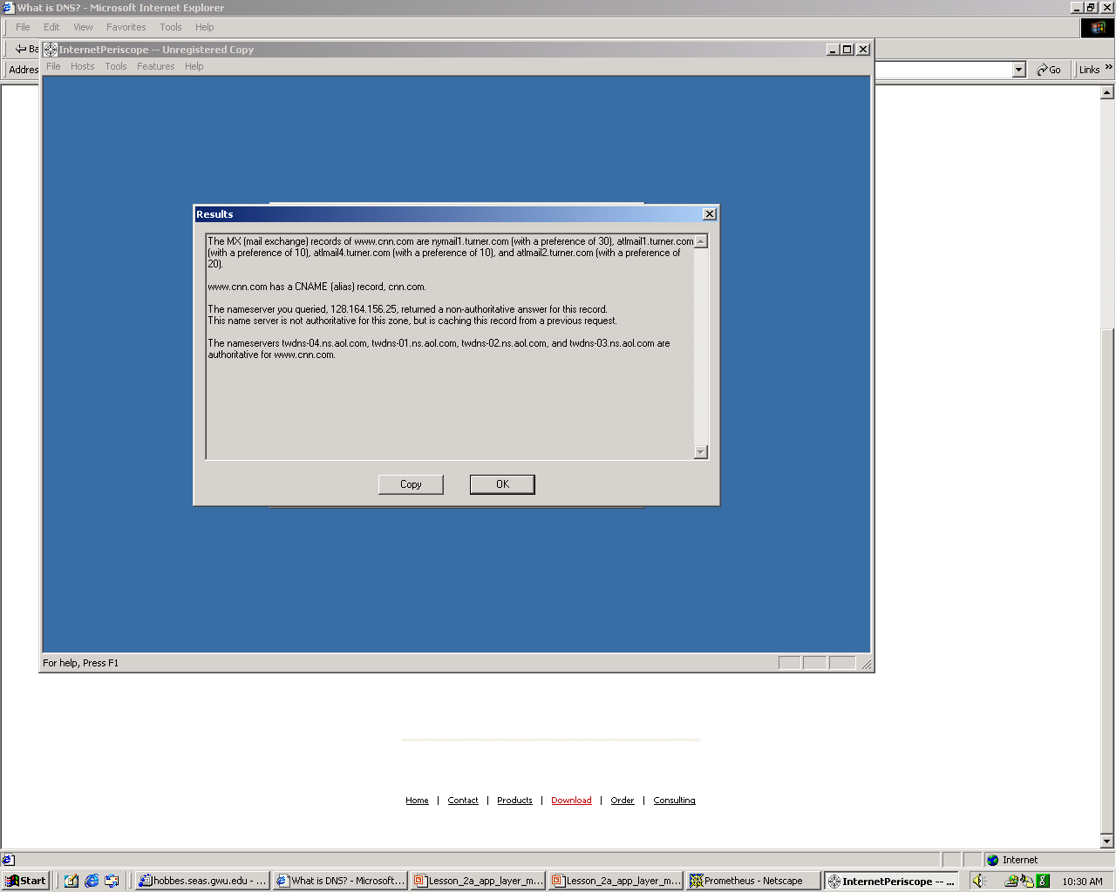
Examples

Slide 35

DNS protocol, messages
DNS protocol : query and reply messages, both with same message format
msg header
identification: 16 bit # for query, reply to query uses same #
flags:
  query or reply
  recursion desired
  recursion available
  reply is authoritative

Slide 36
DNS protocol, messages
Name, type fields
for a query
RRs in response
to query
records for
authoritative servers
additional “helpful”
info that may be used

Slide 37
Socket programming
Goal: learn how to build client/server application that communicate using sockets
Socket API
introduced in BSD4.1 UNIX, 1981
explicitly created, used, released by apps
client/server paradigm
two types of transport service via socket API:
  unreliable datagram
  reliable, byte stream-oriented
socket
a host-local, application-created/owned,
OS-controlled interface (a “door”) into which
application process can both send and
receive messages to/from another (remote or
local) application process

Slide 38
Socket-programming using TCP
Socket: a door between application process and end-end-transport protocol (UCP or TCP)
TCP service: reliable transfer of bytes from one process to another
controlled by
application
developer
controlled by
application
developer
process
process
socket
socket
TCP with
buffers,
variables
TCP with
buffers,
variables
controlled by
operating
system
controlled by
operating
system
internet
host or
server
host or
server

Slide 39
Socket programming with TCP
Client must contact server
server process must first be running
server must have created socket (door) that welcomes client’s contact
Client contacts server by:
creating client-local TCP socket
specifying IP address, port number of server process
When client creates socket: client TCP establishes connection to server TCP
When contacted by client, server TCP creates new socket for server process to communicate with client
  allows server to talk with multiple clients
application viewpoint
TCP provides reliable, in-order
transfer of bytes (“pipe”)
between client and server

Slide 40
Socket programming with TCP
Example client-server app:
client reads line from standard input (inFromUser stream) , sends to server via socket (outToServer stream)
server reads line from socket
server converts line to uppercase, sends back to client
client reads, prints modified line from socket (inFromServer stream)
Input stream: sequence of bytes into process
Output stream: sequence of bytes out of process
outToServer
iinFromServer
inFromUser
client socket

Slide 41
Client/server socket interaction: TCP
Server (running on hostid)
Client
create socket,
port=x, for
incoming request:
welcomeSocket =
ServerSocket()
TCP
connection setup
create socket,
connect to hostid, port=x
wait for incoming
connection request
connectionSocket =
welcomeSocket.accept()
clientSocket =
Socket()
send request using
clientSocket
read request from
connectionSocket
write reply to
connectionSocket
read reply from
clientSocket
close
connectionSocket
close
clientSocket

Slide 42
Example: Java client (TCP)
import java.io.*;
import java.net.*;
class TCPClient {
public static void main(String argv[ ]) throws Exception
{
String sentence;
String modifiedSentence;
BufferedReader inFromUser =
new BufferedReader(new InputStreamReader(System.in));
Socket clientSocket = new Socket("hostname", 6789);
DataOutputStream outToServer =
new DataOutputStream(clientSocket.getOutputStream());
Create
input stream
Create
client socket,
connect to server
Create
output stream
attached to socket

Slide 43
Example: Java client (TCP), cont.
Create
input stream
attached to socket
BufferedReader inFromServer =
new BufferedReader(new
InputStreamReader(clientSocket.getInputStream()));
sentence = inFromUser.readLine();
outToServer.writeBytes(sentence + '\n');
modifiedSentence = inFromServer.readLine();
System.out.println("FROM SERVER: " + modifiedSentence);
clientSocket.close();
}
}
Send line
to server
Read line
from server

Slide 44
Example: Java server (TCP)
import java.io.*;
import java.net.*;
class TCPServer {
public static void main(String argv[ ]) throws Exception
{
String clientSentence;
String capitalizedSentence;
ServerSocket welcomeSocket = new ServerSocket(6789);
while(true) {
Socket connectionSocket = welcomeSocket.accept();
BufferedReader inFromClient =
new BufferedReader(new
InputStreamReader(connectionSocket.getInputStream()));
Create
welcoming socket
at port 6789
Wait, on welcoming
socket for contact
by client
Create input
stream, attached
to socket

Slide 45
Example: Java server (TCP), cont
Create output
stream, attached
to socket
DataOutputStream outToClient =
new DataOutputStream(connectionSocket.getOutputStream());
clientSentence = inFromClient.readLine();
capitalizedSentence = clientSentence.toUpperCase() + '\n';
outToClient.writeBytes(capitalizedSentence);
}
}
}
Read in line
from socket
Write out line
to socket
End of while loop,
loop back and wait for
another client connection

Slide 46
Socket programming with UDP
UDP: no “connection” between client and server
no handshaking
sender explicitly attaches IP address and port of destination
server must extract IP address, port of sender from received datagram
UDP: transmitted data may be received out of order, or lost
application viewpoint
UDP provides unreliable transfer
of groups of bytes (“datagrams”)
between client and server

Slide 47
Client/server socket interaction: UDP
Server (running on hostid)
Client
create socket,
port=x, for
incoming request:
create socket,
clientSocket =
DatagramSocket()
serverSocket =
DatagramSocket()
Create, address (hostid, port=x,
send datagram request
using clientSocket
read request from
serverSocket
write reply to
serverSocket
specifying client
host address,
port umber
read reply from
clientSocket
close
clientSocket

Slide 48
Example: Java client (UDP)
import java.io.*;
import java.net.*;
class UDPClient {
public static void main(String args[]) throws Exception
{
BufferedReader inFromUser =
new BufferedReader(new InputStreamReader(System.in));
DatagramSocket clientSocket = new DatagramSocket();
InetAddress IPAddress = InetAddress.getByName("hostname");
byte[] sendData = new byte[1024];
byte[] receiveData = new byte[1024];
String sentence = inFromUser.readLine();
sendData = sentence.getBytes();
Create
input stream
Create
client socket
Translate
hostname to IP
address using DNS

Slide 49
Example: Java client (UDP), cont.
Create datagram with data-to-send,
length, IP addr, port
DatagramPacket sendPacket =
new DatagramPacket(sendData, sendData.length, IPAddress, 9876);
clientSocket.send(sendPacket);
DatagramPacket receivePacket =
new DatagramPacket(receiveData, receiveData.length);
clientSocket.receive(receivePacket);
String modifiedSentence =
new String(receivePacket.getData());
System.out.println("FROM SERVER:" + modifiedSentence);
clientSocket.close();
}
}
Send datagram
to server
Read datagram
from server

Slide 50
Example: Java server (UDP)
import java.io.*;
import java.net.*;
class UDPServer {
public static void main(String args[]) throws Exception
{
DatagramSocket serverSocket = new DatagramSocket(9876);
byte[ ] receiveData = new byte[1024];
byte[ ] sendData = new byte[1024];
while(true)
{
DatagramPacket receivePacket =
new DatagramPacket(receiveData, receiveData.length);
serverSocket.receive(receivePacket);
Create
datagram socket
at port 9876
Create space for
received datagram
Receive
datagram

Slide 51
Example: Java server (UDP), cont
String sentence = new String(receivePacket.getData());
InetAddress IPAddress = receivePacket.getAddress();
int port = receivePacket.getPort();
String capitalizedSentence = sentence.toUpperCase();
sendData = capitalizedSentence.getBytes();
DatagramPacket sendPacket =
new DatagramPacket(sendData, sendData.length, IPAddress,
port);
serverSocket.send(sendPacket);
}
}
}
Get IP addr
port #, of
sender
Create datagram
to send to client
Write out
datagram
to socket
End of while loop,
loop back and wait for
another datagram

Slide 52
Chapter 2: Summary
Our study of network apps now complete!
application service requirements:
  reliability, bandwidth, delay
client-server paradigm
Internet transport service model
  connection-oriented, reliable: TCP
  unreliable, datagrams: UDP
specific protocols:
  http
  ftp
  smtp, pop3
  dns
socket programming
  client/server implementation
  using tcp, udp sockets

Slide 53
Chapter 2: Summary
Most importantly: learned about protocols
typical request/reply message exchange:
  client requests info or service
  server responds with data, status code
message formats:
  headers: fields giving info about data
  data: info being communicated
control vs. data msgs
  in-based, out-of-band
centralized vs. decentralized
stateless vs. stateful
reliable vs. unreliable msg transfer
“complexity at network edge”
security: authentication

